Slide 1
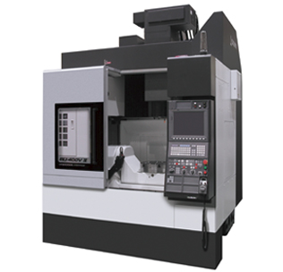
Towards Automated Guidance For Helping Novices Design For Sustainable Additive Manufacturing And CNC Machining
Ruoyu Song
PhD Proposal Presentation
4/12/2018

Slide 2
Manufacturing activities significantly influence the environment.
US Industrial Sector in 2006
Manufacturing
12%
36%
Manufacturing
90%
84%
Manufacturing
Manufacturing
Introduction
Goal and Scope
Literature Review
Research Tasks
Research Timeline
Expected Contribution

Slide 3
Fabrication failures increase the environmental impacts
Fabrication failures could have significant impacts of the total building costs.
The breakdown of a single CNC lathe may halt the entire production process [3].
In selective laser sintering, the expected cost by build failures was responsible for up to 38% of total costs [4].
Good design and planning can reduce the fabrication failures.
Novices may not have enough knowledge to deliver good design and planning.
Introduction
Goal and Scope
Literature Review
Research Tasks
Research Timeline
Expected Contribution

Slide 4
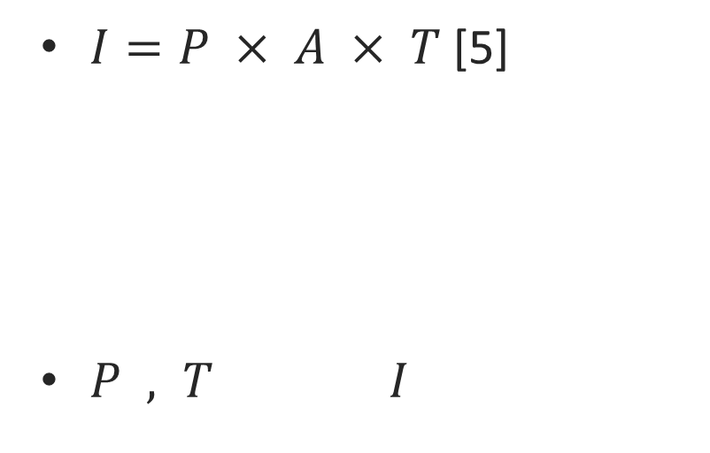
The environmental impacts increase for CAM due to novices.
$I=P × A × T$ [5]
$P , T I$
Technology
Affluence
Population
Impact on the environment
In a 3D printing makerspaces mainly used by novices
34.6% of material was wasted
Actual energy consumption was 50% more than under controlled experiments
Introduction
Goal and Scope
Literature Review
Research Tasks
Research Timeline
Expected Contribution
Notes:
the number of users, $P$, is increasing and mistakes by these additional users increases the environmental cost of manufacturing technology, $T$, as well increases. These two factors contribute the overall environment impact, I, represented conceptually in the IPAT equation [1]
$A$ stands for affluence, which represents the average consumption of each person in the population. Even if $A$ is assumed to be constant, the environmental impacts increase for CAM.

Slide 5
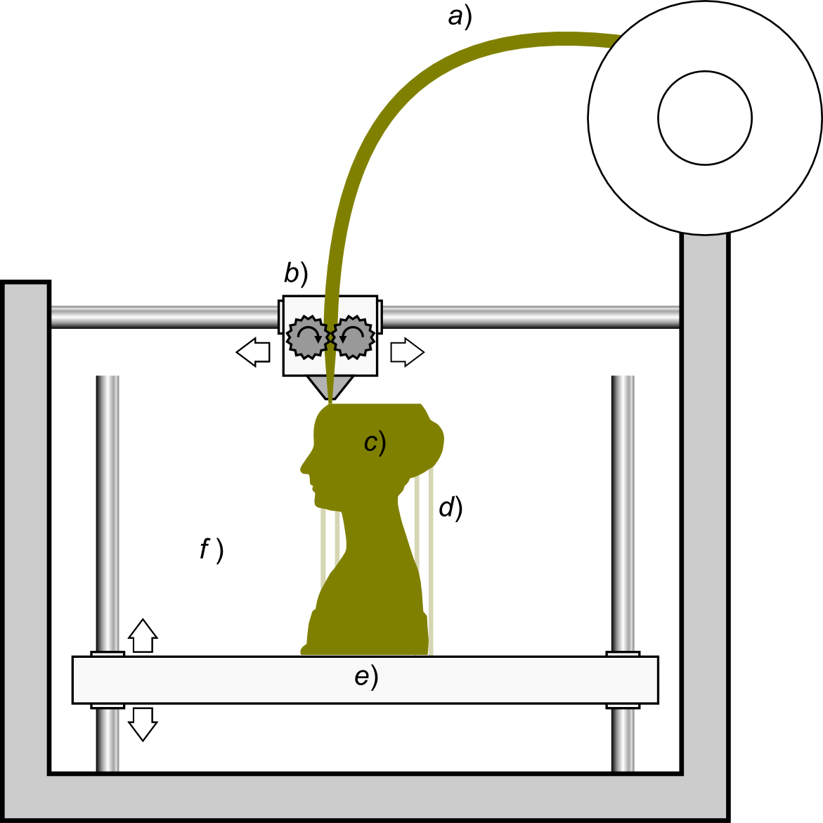
Fused Deposition Modeling (FDM) for Additive Manufacturing (AM) CNC Machining for Subtractive Manufacturing (SM)
Introduction
Goal and Scope
Literature Review
Research Tasks
Research Timeline
Expected Contribution

Slide 6
Lots of Design for Manufacturing (DFM) guidelines exist.
DFM guidelines should be used to decrease the environmental impacts and fabrication failures of CAM processes.
For conventional manufacturing including machining, DFM guidelines are well developed [6-9].
Many studies have been done to develop the Design for AM (DfAM) guidelines for general and specific AM processes [6, 10-15].
Useful DFM guidelines were proposed, but few of them were written in a way that is accessible to novice users [15].
Introduction
Goal and Scope
Literature Review
Research Tasks
Research Timeline
Expected Contribution

Slide 7
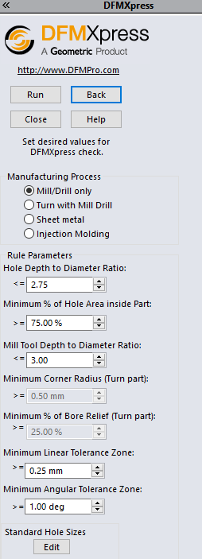
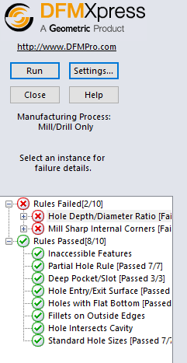
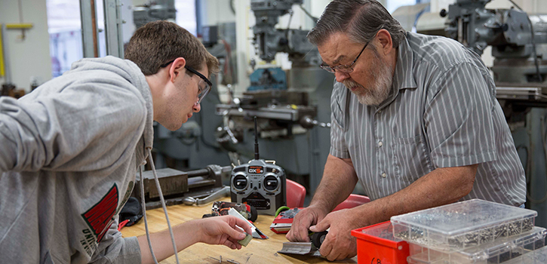
Current feedback approaches are insufficient for novices
https://engineering.wustl.edu/our-school/leadership/offices/marketing-communications/magazine/PublishingImages/Harkins_725x350.jpg
Introduction
Goal and Scope
Literature Review
Research Tasks
Research Timeline
Expected Contribution

Slide 8
This research proposes to provide a new feedback framework
+ ?=
+
New Feedback System
What feedback content should be provided to novice designers
What feedback strategies to communicate the content
Introduction
Goal and Scope
Literature Review
Research Tasks
Research Timeline
Expected Contribution

Slide 9
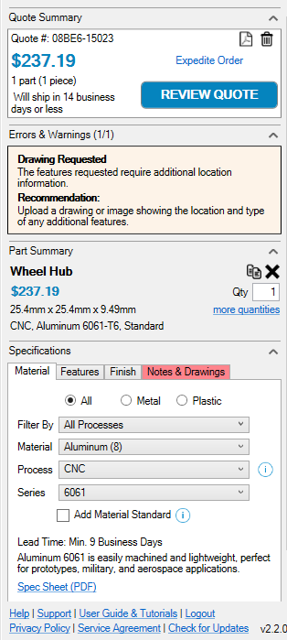
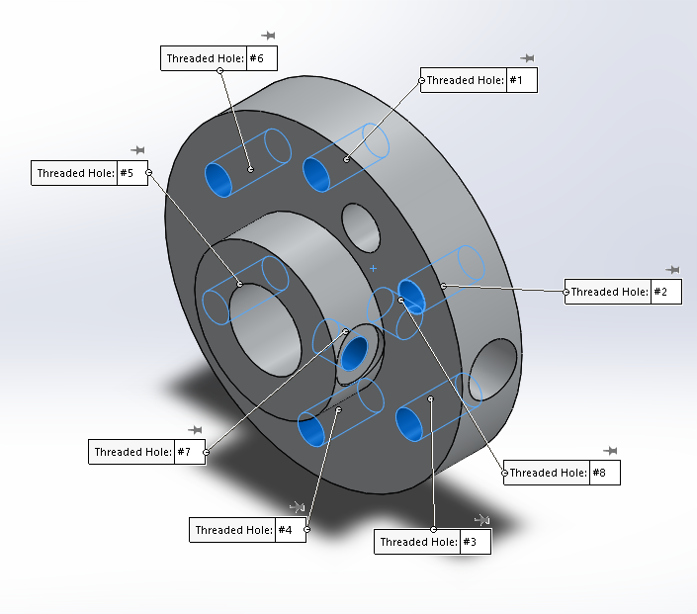
Feedback content and feedback strategies
Introduction
Goal and Scope
Literature Review
Research Tasks
Research Timeline
Expected Contribution

Slide 10
Environmental impacts of CAM
For SM, the energy consumption results over 99% of the environmental impact [16].
Two energy consumption sources [17]
energy of auxiliary machine movements
intrinsic process movements.
For AM, most studies focused on energy use [20-24].
Manufacturers could reduce energy consumption for small production volumes [22].
Faludi et al. found that the sustainability of AM depends primarily on the utilization, and then on the specific machines [24].
For AM and SM, energy consumption estimation methods were developed [16,18-19,25-26].
Introduction
Goal and Scope
Literature Review
Research Tasks
Research Timeline
Expected Contribution

Slide 11
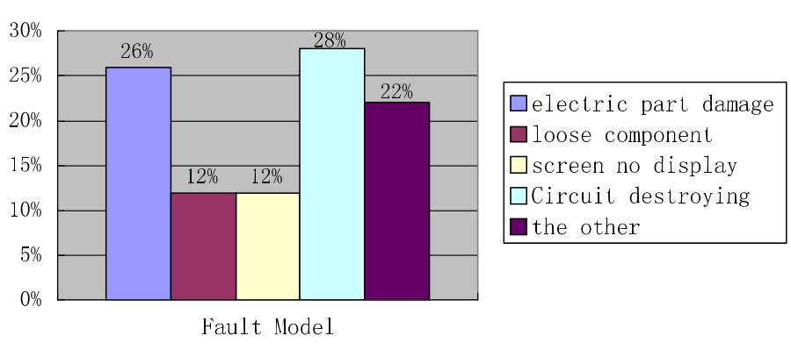
Fabrication failures of subtractive manufacturing
Fabrication failures could have significant impacts of the total building costs.
The scrap production in conventional machining ranges from 10% to 60% [27]
Histogram of failure mode [28]
Introduction
Goal and Scope
Literature Review
Research Tasks
Research Timeline
Expected Contribution

Slide 12
Fabrication failures of additive manufacturing
Few studies have looked at the potential material consumption and build failure under consumer operating conditions.
The actual material waste of 3D printing is larger than that predicted by studies using ideal operating conditions without human or printer error [30].
Some studies investigated the influence of design and processing parameters on AM. [31-33].
Guides are available to identify and resolve issues of 3D printers [34-36].
Introduction
Goal and Scope
Literature Review
Research Tasks
Research Timeline
Expected Contribution

Slide 13
Most DfAM guidelines are not for novices
Increasing number of novice engineering designers can access to AM. However, they do not have knowledge of the AM processes and DfAM.
Booth et al. found that useful DfAM guidelines were proposed, but few of them were written in a way that is accessible to novice users [15].
Provided a visual DfAM worksheet for novice and intermittent users.
In a high-volume 3D printing facility which serves the entire Purdue University campus, introducing this worksheet decreased the failure rate by 81.7%.
Introduction
Goal and Scope
Literature Review
Research Tasks
Research Timeline
Expected Contribution

Slide 14
Automated DFM Approaches and Methodologies for CAM
Denkena et al. highlighted the knowledge and collaboration gap between designers and manufacturers, and the lack of appropriate software tools to support this collaboration [37]. A systematic feedback system could improve the product manufacturability [38].
The use of annotated models is a valuable approach to improve design intent communication. Graphic user interfaces that are customized to expertise increase the accessibility of information [41].
For SM, approaches are developed to close the knowledge gap between manufacturer and designer [38-40].
For AM, automated DfAM methodologies are developed [42-46].
Yang and Zhao concluded that DfAM research rarely considered manufacturability improvement [47].
Introduction
Goal and Scope
Literature Review
Research Tasks
Research Timeline
Expected Contribution

Slide 15
Research Tasks
The goal of this research is to assist novice engineering designers to make design decisions to reduce environmental impacts of CAM technologies.
Three main tasks will be done to achieve the research goal:
Task 1: Collect data related to feedback of CAM technologies
Task 2: Process collected data to improve feedback contents and strategies for novices
Task 3: Validate the feedback using software prototype
Introduction
Goal and Scope
Literature Review
Research Tasks
Research Timeline
Expected Contribution

Slide 16
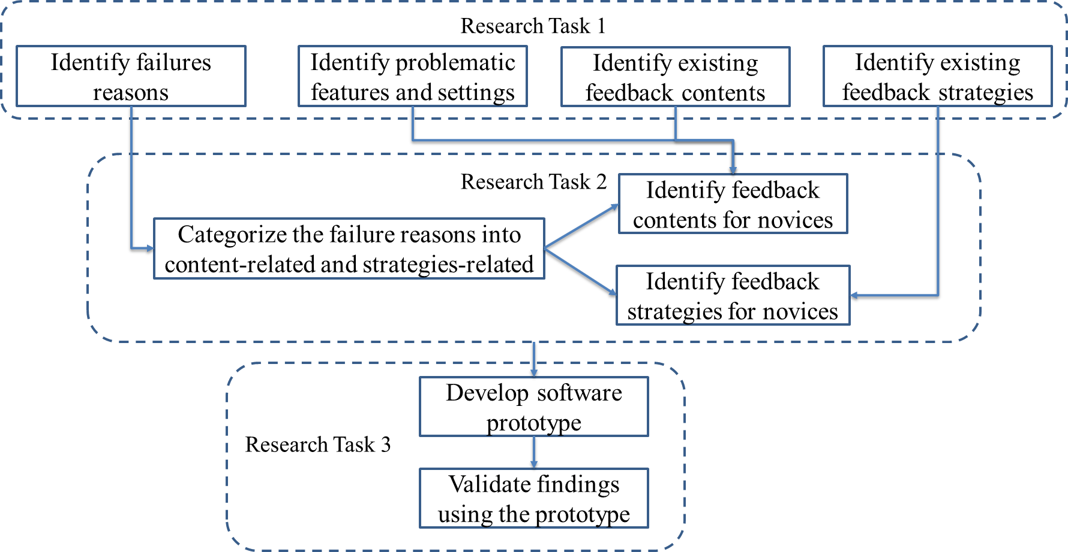
Research Roadmap
Introduction
Goal and Scope
Literature Review
Research Tasks
Research Timeline
Expected Contribution

Slide 17
Task 1: Collect data related to feedback of CAM technologies
Aims:
Existing feedback content and strategies will be identified from literature review and benchmarking study. Feedback-related data will be collected from observations in the university makerspaces and interviews of designers and machinists.
Four sub-tasks will be done
Sub-Task 1.1: Literature review and benchmarking studies
Sub-Task 1.2: Interviews of designers and machinists for CNC machining
Sub-Task 1.3: Observations in the university machining mall
Sub-Task 1.4: Data collection in the university makerspace for FDM
Introduction
Goal and Scope
Literature Review
Research Tasks
Research Timeline
Expected Contribution

Slide 18
Sub-Task 1.1: Literature review and benchmarking studies
Research question:
What are the existing feedback content?
What are the existing feedback strategies?
Methodology:
The existing feedback content including DFM guidelines and design suggestions will be identified from literatures.
Benchmarking studies will be done on available software (Xometry, DFMXpress, etc.)
Introduction
Goal and Scope
Literature Review
Research Tasks
Research Timeline
Expected Contribution

Slide 19
Current Progress: DFM guidelines
Existing DFM guidelines for both machining and FDM are summarized from literature
DFM guidelines for machining
General guidelines
Guidelines for drilling, milling, reaming, boring, planing, shaping and slotting
DFM guidelines for fused feposition modeling
Introduction
Goal and Scope
Literature Review
Research Tasks
Research Timeline
Expected Contribution

Slide 20
Current Progress: Benchmarking study of Xometry
Third party SolidWorks plug-in that provides instant feedback on pricing, lead time, design errors and design recommendations
Introduction
Goal and Scope
Literature Review
Research Tasks
Research Timeline
Expected Contribution

Slide 21
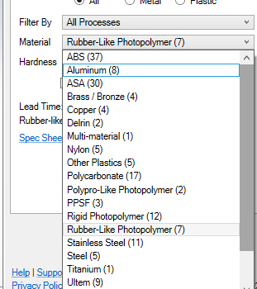
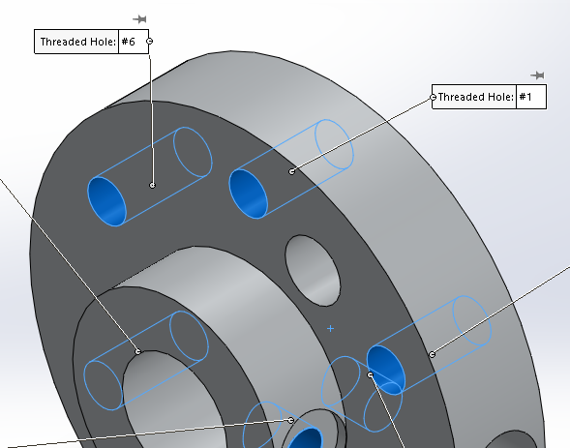
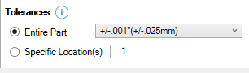
Current Progress: Benchmarking study of Xometry
Does not provide warnings if unnecessarily tight tolerances are set
Extensive range of materials and manufacturing processes could be a little overwhelming for novice designers.
Does not treat ‘Extruded Cuts’ as holes
Introduction
Goal and Scope
Literature Review
Research Tasks
Research Timeline
Expected Contribution

Slide 22
Current Progress: Benchmarking study of DFMXpress
SolidWorks’ own analysis tool that identifies areas that might cause fabrication problems
Limited to four manufacturing processes: Mill/Drill only, Turn with Mill Drill, Sheet metal and Injection Molding.
Introduction
Goal and Scope
Literature Review
Research Tasks
Research Timeline
Expected Contribution

Slide 23
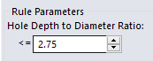
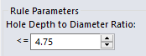
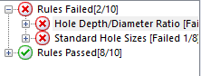
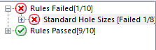
Current Progress: Benchmarking study of DFMXpress
Rule parameters can be set by users, which makes ‘failure’ of CAD parts subjective
Software expects some expertise from the user
Does not take material properties into account
No warnings if extremely tight tolerances are set
Introduction
Goal and Scope
Literature Review
Research Tasks
Research Timeline
Expected Contribution

Slide 24
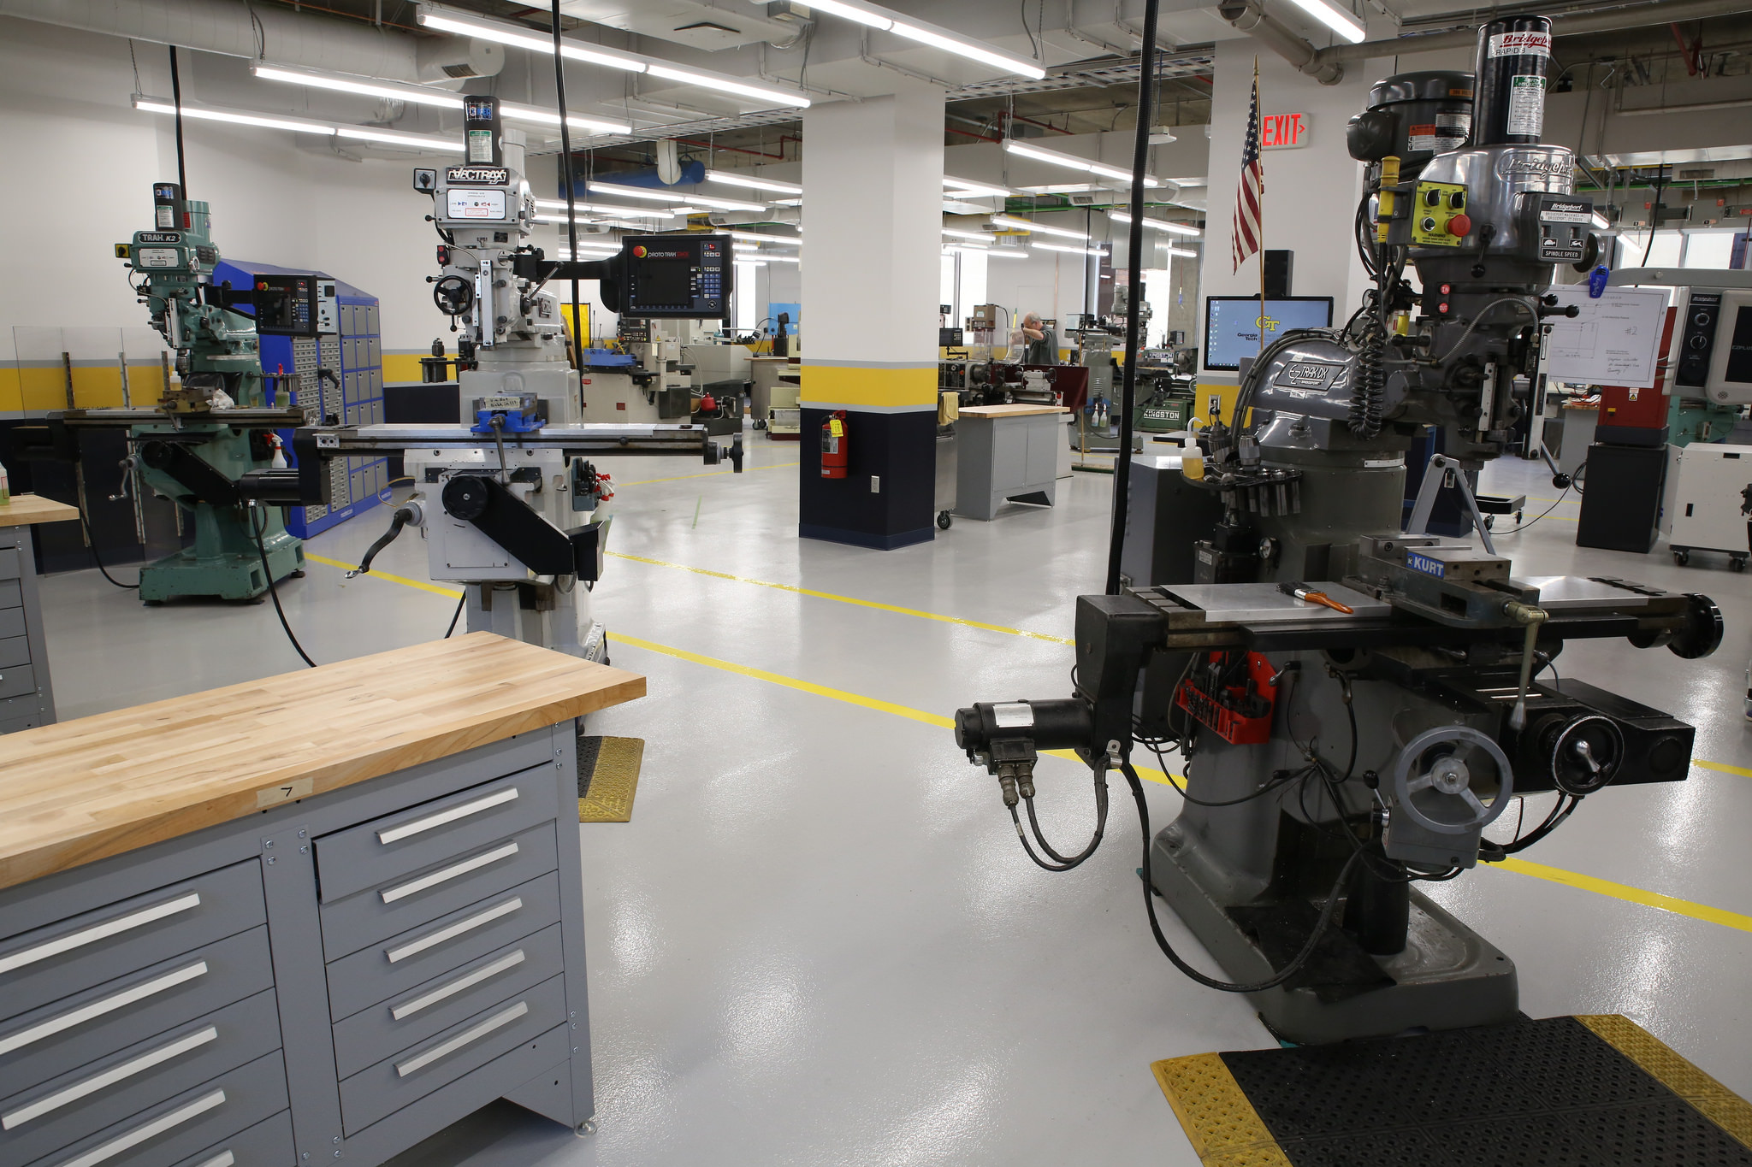
Sub-Task 1.2: Interviews of designers and machinists for CNC machining Sub-Task 1.3: Observations in the university machining mall
Research question:
What are the failure reasons for CNC machining?
What are the problematic features and settings?
What feedback is given to novices by machinists?
How do machinists provide feedback to novices?
Methodology:
Sub-task 1.2:
Interview the novice engineering designers and machinists working with novices
Exact quotes from the interview related to fabrication failures and feedback will be extracted and coded into topics.
Sub-task 1.3:
Observe novices communicating with machinists
Topics and issues mentioned in the communication will be coded
Feedback strategies will be recorded for each communication
Introduction
Goal and Scope
Literature Review
Research Tasks
Research Timeline
Expected Contribution

Slide 25
Current Progress: Topics Mentioned in the Interviews
Topics | Designer | Machinist 1 | Machinist 2 | Machinist 3
Tolerances and Dimensions | x | x | x | x
Hole callouts | x | x | x | x
Surface finish | x | x
Pin fits |  | x | x | x
Feedback system | x | x | x | x
Drawings | x | x | x | x
Designers need to have manufacturing knowledge | x | x | x | x
Experience of designers | x | x | x | x
Design revisions | x |  | x | x
Material cost |  | x | x
Processing cost | x | x | x
Introduction
Goal and Scope
Literature Review
Research Tasks
Research Timeline
Expected Contribution

Slide 26
Current Progress: Topics Mentioned from Observations
Topics | 1 | 2 | 3 | 4 | 5 | 6 | 7 | 8 | 9 | 10 | 11 | 12 | 13 | Total
Tolerances and Dimensions | x |  |  |  |  | x |  | x | x | x |  |  | x | 6
Hole callouts | x |  | x |  |  |  |  | x |  |  | x |  | x | 5
Designers need to have manufacturing knowledge | x |  |  |  | x | x | x |  | x |  | x | x | x | 8
Experience of designers |  |  |  |  |  | x |  |  |  |  |  |  |  | 1
Design revisions | x |  |  |  |  |  |  |  | x |  |  |  |  | 2
Material selection | x |  |  |  |  |  |  |  |  |  |  |  | x | 2
How to assemble | x |  |  |  |  |  | x |  | x |  | x |  | x | 5
Lead time | x | x |  | x |  | x |  |  | x |  |  |  |  | 5
Introduction
Goal and Scope
Literature Review
Research Tasks
Research Timeline
Expected Contribution

Slide 27
Current Progress: Artifacts Used from Observations
Topics | 1 | 2 | 3 | 4 | 5 | 6 | 7 | 8 | 9 | 10 | 11 | 12 | 13 | #
Feedback system |  |  |  |  |  |  |  |  | x | x |  |  |  | 2
Drawings | x | x | x |  | x |  |  |  | x | x |  |  | x | 7
CAD model |  |  | x |  |  |  | x |  |  | x | x |  | x | 5
Physical parts/blanks |  |  |  | x |  | x |  | x | x |  |  | x | x | 6
Sketches |  |  |  | x |  |  |  |  |  |  |  |  |  | 1
Introduction
Goal and Scope
Literature Review
Research Tasks
Research Timeline
Expected Contribution

Slide 28
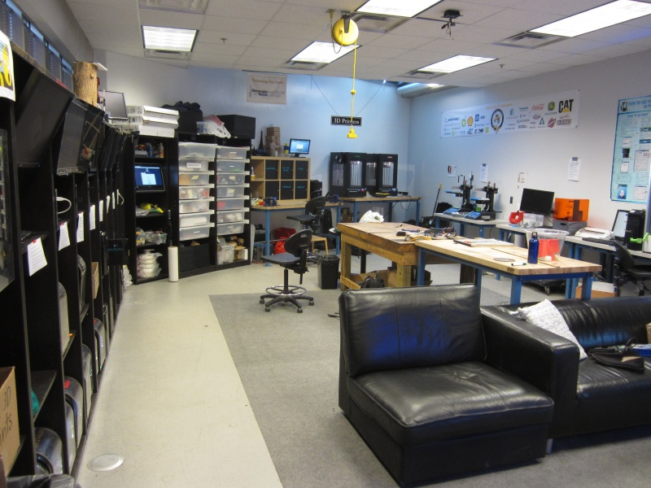
Sub-Task 1.4: Data collection in the university makerspace for FDM
Research questions:
What are the failure reasons for FDM?
What are the problematic features and settings?
What feedback is given to designers by software?
How do software provide feedback?
Introduction
Goal and Scope
Literature Review
Research Tasks
Research Timeline
Expected Contribution

Slide 29
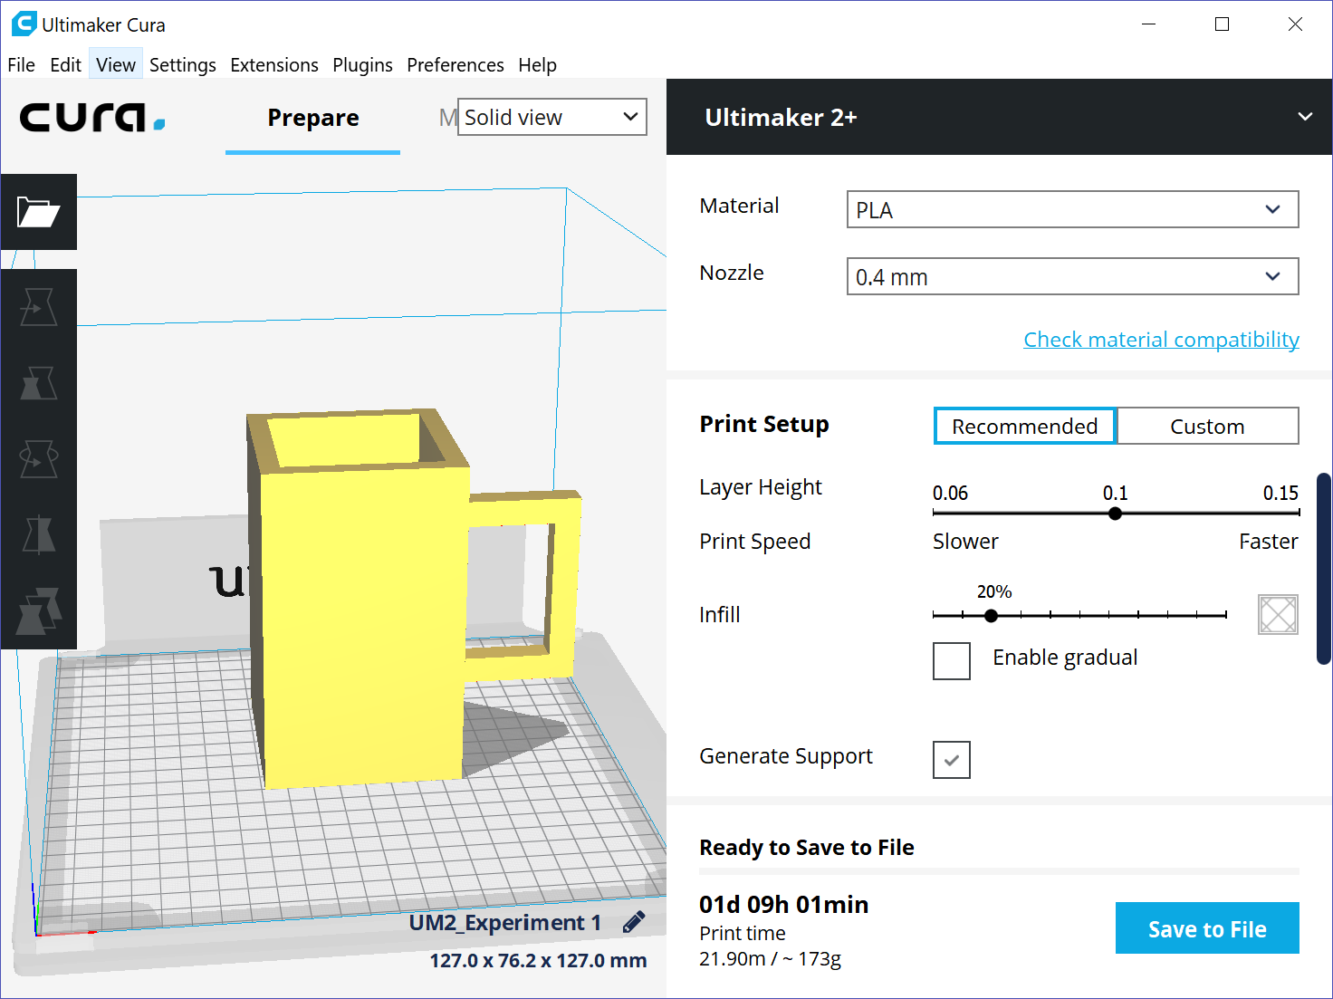
Collect users’ expertise information, CAD model and printing settings
Expertise information:
Major
Year of study
Number of parts printed
Frequency of printing
Number of projects done using CAD software
Introduction
Goal and Scope
Literature Review
Research Tasks
Research Timeline
Expected Contribution

Slide 30
Current Progress: Failure modes caused by designer errors can be solved by providing feedback content.
Type | Machine Operator Error | Machine Error | Designer Error
Unused Filament | X | X
Platform Heating | X | X
Part Shape | X |  | X
Layer Shift |  | X | X
Support Material Removing | X |  | X
Printer Stops | X | X | X
Calibration | X | X
Skip Layers |  | X
Non-Physical Defect |  |  | X
Introduction
Goal and Scope
Literature Review
Research Tasks
Research Timeline
Expected Contribution

Slide 31
Current Progress: 29 printings were collected, 13 were failures.
Category | Reason | # of Prints
Designer | Overhang | 1
 | Complex features | 1
 | Tall and thin part | 1
Operator | Did not generate support | 3
 | Printed out of area | 1
 | Loose calibration | 1
 | Platform was moved | 1
 | Filament tangled | 2
Machine | Under extrusion | 1
 | Nozzle clogged | 1
Introduction
Goal and Scope
Literature Review
Research Tasks
Research Timeline
Expected Contribution

Slide 32
Current Progress: Novices need more support from principal component analysis.
Category | PC1 | PC2 | PC3
Year of Study | 0.68 | -0.44 | -0.57
CAD Projects Experience | 0.56 | -0.03 | 0.52
Number of Parts Printed | 0.28 | -0.08 | 0.60
Printing Frequency | 0.38 | 0.89 | -0.20
% of Total | 52.5 | 41.5 | 5.9
Introduction
Goal and Scope
Literature Review
Research Tasks
Research Timeline
Expected Contribution

Slide 33
Task 2: Process collected data to improve feedback contents and strategies for novices
Aims:
The collected data from Task 1 will be processes to improve the feedback contents and strategies for novice engineering designers. The limitations of existing feedback will be identified.
Three sub-tasks will be done
Sub-Task 2.1: Categorize the failure reasons to feedback content related and strategies related
Sub-Task 2.2: Improve feedback contents provided to novices
Sub-Task 2.3: Improve feedback strategies to provide feedback contents
Introduction
Goal and Scope
Literature Review
Research Tasks
Research Timeline
Expected Contribution

Slide 34
Sub-Task 2.1: Categorize the failure reasons to feedback content related and strategies related
Research question:
What are the failure reasons related to feedback contents for CAM technologies used by beginning designers?
What are the failure reasons related to feedback strategies for CAM technologies used by beginning designers?
Methodology:
The failure reasons for CAM technologies identified in Task 1 will be categorized into two groups: feedback content related and feedback strategies related
The failure reasons not related to feedback will not be considered
Introduction
Goal and Scope
Literature Review
Research Tasks
Research Timeline
Expected Contribution

Slide 35
Sub-Task 2.2: Improve feedback contents provided to novices
Research questions:
What are the limitations of existing feedback contents?
What DFM guidelines should be provided to novice designers?
What DFM guidelines should be applied to the design automatically by software?
What design suggestions should be provided to novice designers?
Methodology:
The limitations of existing feedback contents will be identified by comparing the feedback contents and identified failure reasons and problematic features and settings
Develop feedback contents including new guidelines and design suggestions based on the identified limitations
Categorize the DFM guidelines into two groups. Some guidelines are related to design decisions that the designers should modify the design. These type of DFM guidelines should be provided to designers. The other guidelines can be used by the software to automatically adjust the design and notify the designers.
Introduction
Goal and Scope
Literature Review
Research Tasks
Research Timeline
Expected Contribution

Slide 36
Sub-Task 2.3: Improve feedback strategies to provide feedback contents
Research questions:
What are the limitations of existing feedback strategies?
What feedback strategies can decrease the fabrication failures?
Methodology:
Identify he limitations of existing feedback strategies by comparing the strategies used by machinists and automated software and failure reasons
Improve current feedback strategies to lift the limitations
Identify the effective feedback strategies used by the machinist but not used by existing automated software. Then implemented these strategies with automated computer methodologies
Introduction
Goal and Scope
Literature Review
Research Tasks
Research Timeline
Expected Contribution

Slide 37
Task 3: Validate the feedback using software prototype
Aims:
This developed prototype can simulate how to assist beginning designers to change design decisions to decrease the environmental impacts, which validates the identified feedback content and strategies.
Three sub-tasks will be done
Sub-Task 3.1: Validate the identified feedback content
Sub-Task 3.2: Develop software prototype
Sub-Task 3.3: Validate the findings using the prototype
Introduction
Goal and Scope
Literature Review
Research Tasks
Research Timeline
Expected Contribution

Slide 38
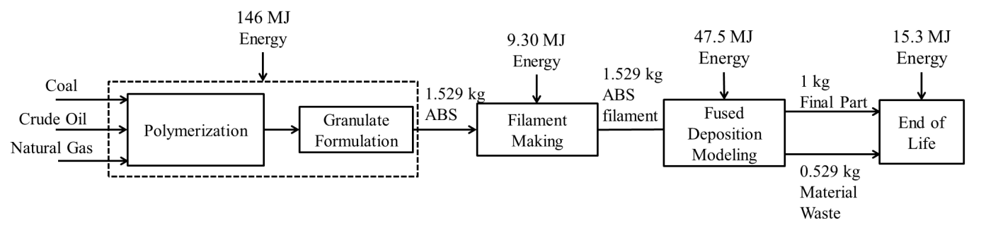
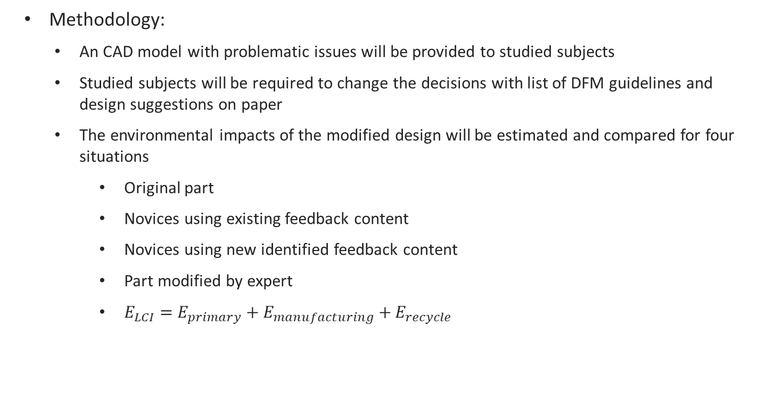
Sub-Task 3.1: Verify the identified feedback content
Methodology:
An CAD model with problematic issues will be provided to studied subjects
Studied subjects will be required to change the decisions with list of DFM guidelines and design suggestions on paper
The environmental impacts of the modified design will be estimated and compared for four situations
Original part
Novices using existing feedback content
Novices using new identified feedback content
Part modified by expert
$E_{LCI}=E_{primary}+E_{manufacturing}+E_{recycle}$
Introduction
Goal and Scope
Literature Review
Research Tasks
Research Timeline
Expected Contribution

Slide 39
Sub-Task 3.2: Develop Wizard-of-Oz software prototype
Research question:
What is the algorithm for the software prototype?
What are the study cases?
What are users’ responses for the software?
Methodology:
SolidWorks will be used as the CAD software. SculptPrint and Cura will be used as the CAM software.
Objects will be chosen as study cases representing the common design issues identified in Task 1.
Volunteers fall under the category of novice engineering designers will be recruited and provide their responses based on preliminary prototype.
The prototype will be built using the identified feedback content and strategies, developed algorithm, and the identified responses.
Introduction
Goal and Scope
Literature Review
Research Tasks
Research Timeline
Expected Contribution

Slide 40
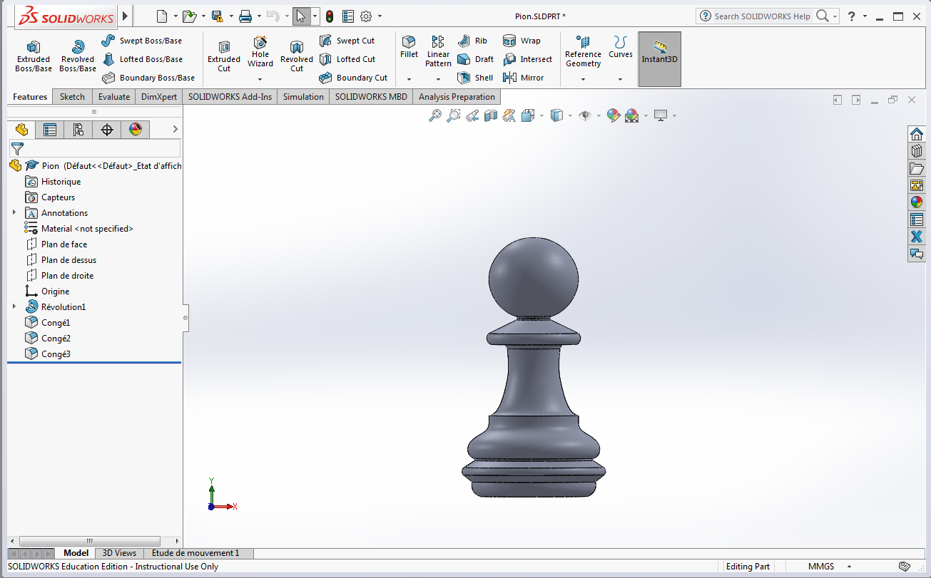
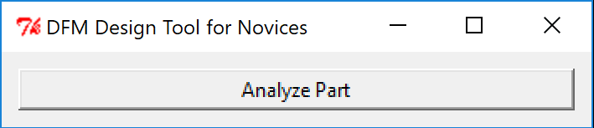
Current Progress:
Introduction
Goal and Scope
Literature Review
Research Tasks
Research Timeline
Expected Contribution

Slide 41
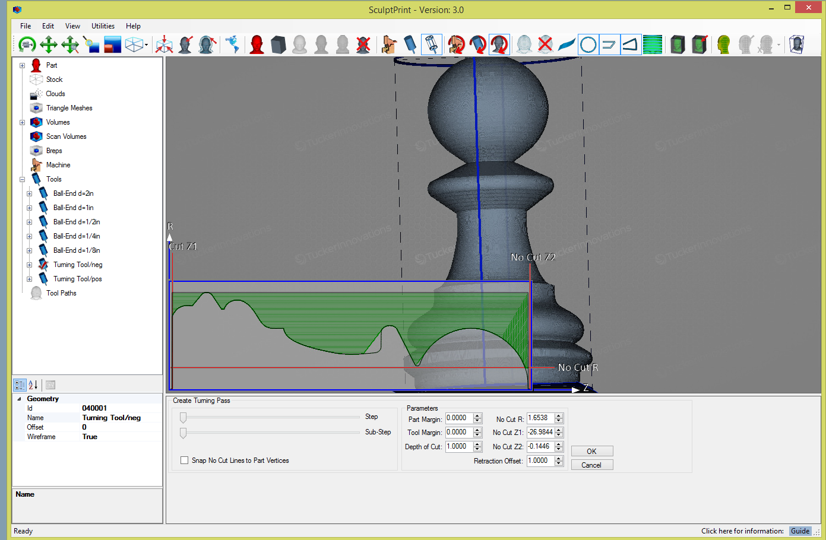
Analyze the part using SculptPrint

Slide 42
Output the tool path and created volume picture to designer

Slide 43
Sub-Task 3.3: Validate the findings using the prototype
Methodology:
An CAD model with problematic issues will be provided to studied subjects
Studied subjects will be required to change the decision use software
The environmental impacts of the modified design will be estimated and compared for two situations, and also compared with the environmental compacts in Sub-Task 3.1
Novices using Xometry
Novices using the developed Wizard-of-Oz prototype
Introduction
Goal and Scope
Literature Review
Research Tasks
Research Timeline
Expected Contribution

Slide 44
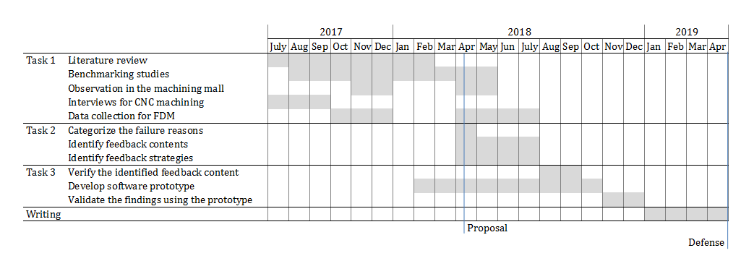
Timeline
Introduction
Goal and Scope
Literature Review
Research Tasks
Research Timeline
Expected Contribution

Slide 45
Expected Contributions
The fabrication failures related to feedback systems and their impacts will be identified for both additive manufacturing and CNC machining.
New feedback content and feedback strategies will be developed from this research and implemented into the automated software tool.
This research is expected to develop an automated design for CAM guidance software framework for novices.
By using this automated guidance software tool, the novice engineering designers can make better design decisions, decrease fabrication failures, decrease environmental impacts, and increase the manufacturing efficiencies.
In addition, this framework can also be applied to other manufacturing processes, such as hybrid manufacturing.
Introduction
Goal and Scope
Literature Review
Research Tasks
Research Timeline
Expected Contribution

Slide 46
Thank you!
The research is supported by the National Science Foundation under grant No. 1631803.
Committee Members:
Dr. Cassandra Telenko, Mechanical Engineering
Dr. Thomas Kurfess, Mechanical Engineering
Dr. Christopher Saldana, Mechanical Engineering
Dr. Yan Wang, Mechanical Engineering
Dr. Frank Durso, Psychology

Slide 47
Thank you!
Questions?

Slide 48
References
[1] USDOC, 2012, Gross Domestic Product (GDP) by Industry Data.
[2] EIA, 2006, 2002 Manufacturing Energy Consumption Survey.
[3] Keller, A. Z., Kamath, A. R. R., and Perera, U. D., 1982, “Reliability Analysis of CNC Machine Tools,” Reliab. Eng., 3(6), pp. 449–473.
[4] Baumers, M., and Holweg, M., 2016, “Cost Impact of the Risk of Build Failure in Laser Sintering,” Proceedings of the Solid Freeform Fabrication Symposium 2016, University of Texas at Austin.
[5] Ehrlich, P. R., and Holdren, J. P., 1971, “Impact of Population Growth,” Science (80-. )., 171(3977), pp. 1212–1217.
[6] Sherif D. El Wakil, 1989, Processes and Design for Manufacturing, Prentice Hall.
[7] Boothroyd, G., 1994, “Product Design for Manufacture and Assembly,” Comput. Des., 26(7), pp. 505–520.
[8] Bralla, J. G., 1999, Design for Manufacturability Handbook, McGraw-Hill.
[9] Poli, C., 2001, Design for Manufacturing: A Structured Approach, Butterworth-Heinemann.
[10] Becker, R., Grzesiak, A., and Henning, A., 2005, “Rethink Assembly Design,” Assem. Autom., 25(4), pp. 262–266.
[11] Atzeni, E., Iuliano, L., Minetola, P., and Salmi, A., 2010, “Redesign and Cost Estimation of Rapid Manufactured Plastic Parts,” Rapid Prototyp. J., 16(5), pp. 308–317.
[12] Thomas, D., 2009, “The Development of Design Rules for Selective Laser Melting,” University of Wales.
[13] Adam, G. A. O., and Zimmer, D., 2014, “Design for Additive Manufacturing—Element Transitions and Aggregated Structures,” CIRP J. Manuf. Sci. Technol., 7(1), pp. 20–28.
[14] Lieneke, T., Denzer, V., Adam, G. A. O., and Zimmer, D., 2016, “Dimensional Tolerances for Additive Manufacturing: Experimental Investigation for Fused Deposition Modeling,” Procedia CIRP, 43, pp. 286–291.
[15] Booth, J. W., Alperovich, J., Chawla, P., Ma, J., Reid, T. N., and Ramani, K., 2017, “The Design for Additive Manufacturing Worksheet,” J. Mech. Des., 139(10).
[16] Li, W., and Kara, S., 2011, “An Empirical Model for Predicting Energy Consumption of Manufacturing Processes: A Case of Turning Process,” Proc. Inst. Mech. Eng. Part B J. Eng. Manuf., 225(9), pp. 1636–1646.
[17] He, K., Tang, R., Zhang, Z., and Sun, W., 2016, “Energy Consumption Prediction System of Mechanical Processes Based on Empirical Models and Computer-Aided Manufacturing,” J. Comput. Inf. Sci. Eng., 16(4), p. 41008.
[18] Overcash, M., Twomey, J., and Kalla, D., 2009, “Unit Process Life Cycle Inventory for Product Manufacturing Operations,” ASME 2009 International Manufacturing Science and Engineering Conference, Volume 1, ASME, West Lafayette, Indiana, pp. 49–55.

Slide 49
References
[19] Seow, Y., and Rahimifard, S., 2011, “A Framework for Modelling Energy Consumption within Manufacturing Systems,” CIRP J. Manuf. Sci. Technol., 4(3), pp. 258–264.
[20] Baumers, M., Tuck, C., Wildman, R., Ashcroft, I., and Hague, R., 2011, “Energy Inputs to Additive Manufacturing: Does Capacity Utilization Matter?,” Solid Freeform Fabrication Symposium, Austin, TX, pp. 30–40.
[21] Kreiger, M., and Pearce, J. M., 2013, “Environmental Life Cycle Analysis of Distributed Three-Dimensional Printing and Conventional Manufacturing of Polymer Products,” ACS Sustain. Chem. Eng., 1(12), pp. 1511–1519.
[22] Mognol, P., Lepicart, D., and Perry, N., 2006, “Rapid Prototyping: Energy and Environment in the Spotlight,” Rapid Prototyp. J., 12(1), pp. 26–34.
[23] Telenko, C., and Seepersad, C., 2012, “A Comparison of the Energy Efficiency of Selective Laser Sintering and Injection Molding of Nylon Parts,” Rapid Prototyp. J., 18(6), pp. 472–481.
[24] Faludi, J., Bayley, C., Bhogal, S., and Iribarne, M., 2015, “Comparing Environmental Impacts of Additive Manufacturing vs Traditional Machining via Life-Cycle Assessment,” Rapid Prototyp. J., 21, pp. 14–33.
[25] Baumers, M., Tuck, C., Wildman, R., Ashcroft, I., Rosamond, E., and Hague, R., 2013, “Transparency Built-in: Energy Consumption and Cost Estimation for Additive Manufacturing Baumers et Al. Energy and Cost Estimation for Additive Manufacturing,” J. Ind. Ecol., 17(3), pp. 418–431.
[26] Song, R., Lu, Y., Telenko, C., and Wang, Y., 2017, “Manufacturing Energy Consumption Estimation Using Machine Learning Approach,” ASME 2017 International Design Engineering Technical Conferences and Computers and Information in Engineering Conference, ASME, Cleveland, OH, p. V004T05A037.
[27] Kalpakjian, S., and Schmid, S. R., 2014, Manufacturing Engineering and Technology, Pearson Upper Saddle River, NJ, USA.
[28] You, D., and Pham, H., 2016, “Reliability Analysis of the CNC System Based on Field Failure Data in Operating Environments,” Qual. Reliab. Eng. Int., 32(5), pp. 1955–1963.
[29] Wang, Y., Jia, Y., Yu, J., and Yi, S., 1999, “Field Failure Database of CNC Lathes,” Int. J. Qual. Reliab. Manag., 16(4), pp. 330–343.
[30] Song, R., and Telenko, C., 2017, “Material and Energy Loss due to Human and Machine Error in Commercial FDM Printers,” J. Clean. Prod., 148, pp. 895–904.
[31] Alafaghani, A., Qattawi, A., Alrawi, B., and Guzman, A., 2017, “Experimental Optimization of Fused Deposition Modelling Processing Parameters: A Design-for-Manufacturing Approach,” Procedia Manuf., 10(10), pp. 791–803.

Slide 50
References
[32] Onwubolu, G. C., and Rayegani, F., 2014, “Characterization and Optimization of Mechanical Properties of ABS Parts Manufactured by the Fused Deposition Modelling Process,” Int. J. Manuf. Eng., 2014, pp. 1–13.
[33] Seepersad, C. C., Govett, T., Kim, K., Lundin, M., and Pinero, D., 2012, “A Designer’s Guide for Dimensioning and Tolerancing SLS Parts,” 23rd Annual International Solid Freeform Fabrication Symposium, Austin, TX, pp. 921–931.
[34] all3dp.com, “3D Printing Troubleshooting: 34 Common 3D Printing Problems | All3DP” [Online]. Available: https://all3dp.com/1/common-3d-printing-problems-troubleshooting-3d-printer-issues/. [Accessed: 21-Mar-2018].
[35] simplyfy3d, “Print Quality Troubleshooting Guide | Simplify3D Software” [Online]. Available: https://www.simplify3d.com/support/print-quality-troubleshooting/. [Accessed: 21-Mar-2018].
[36] reprap.org, “Print Troubleshooting Pictorial Guide - RepRapWiki” [Online]. Available: http://reprap.org/wiki/Print_Troubleshooting_Pictorial_Guide. [Accessed: 21-Mar-2018].
[37] Lieneke, T., Denzer, V., Adam, G. A. O., and Zimmer, D., 2016, “Dimensional Tolerances for Additive Manufacturing: Experimental Investigation for Fused Deposition Modeling,” Procedia CIRP, 43, pp. 286–291.
[38] Molcho, G., Zipori, Y., Schneor, R., Rosen, O., Goldstein, D., and Shpitalni, M., 2008, “Computer Aided Manufacturability Analysis: Closing the Knowledge Gap between the Designer and the Manufacturer,” CIRP Ann., 57(1), pp. 153–158.
[39] Hoque, A. S. M., Halder, P. K., Parvez, M. S., and Szecsi, T., 2013, “Integrated Manufacturing Features and Design-for-Manufacture Guidelines for Reducing Product Cost under CAD/CAM Environment,” Comput. Ind. Eng., 66(4), pp. 988–1003.
[40] Ferrer, I., Rios, J., and Ciurana, J., 2009, “An Approach to Integrate Manufacturing Process Information in Part Design Phases,” J. Mater. Process. Technol., 209(4), pp. 2085–2091.
[41] Camba, J. D., and Contero, M., 2015, “Assessing the Impact of Geometric Design Intent Annotations on Parametric Model Alteration Activities,” Comput. Ind., 71, pp. 35–45.
[42] Rosen, D. W., 2007, “Computer-Aided Design for Additive Manufacturing of Cellular Structures,” Comput. Aided. Des. Appl., 4(5), pp. 585–594.
[43] Kumke, M., Watschke, H., and Vietor, T., 2016, “A New Methodological Framework for Design for Additive Manufacturing,” Virtual Phys. Prototyp., 11(1), pp. 3–19.
[44] Bin Maidin, S., Campbell, I., and Pei, E., 2012, “Development of a Design Feature Database to Support Design for Additive Manufacturing,” Assem. Autom., 32(3), pp. 235–244.

Slide 51
References
[45] Reddy K., S. N., Maranan, V., Simpson, T. W., Palmer, T., and Dickman, C. J., 2016, “Application of Topology Optimization and Design for Additive Manufacturing Guidelines on an Automotive Component,” ASME 2016 International Design Engineering Technical Conferences and Computers and Information in Engineering Conference, ASME, Ch, p. V02AT03A030.
[46] Ponche, R., Hascoet, J. Y., Kerbrat, O., and Mognol, P., 2012, “A New Global Approach to Design for Additive Manufacturing,” Virtual Phys. Prototyp., 7(2), pp. 93–105.
[47] Yang, S., and Zhao, Y. F., 2015, “Additive Manufacturing-Enabled Design Theory and Methodology: A Critical Review,” Int. J. Adv. Manuf. Technol., 80(1–4), pp. 327–342.

Slide 52
Machinists naturally think of parts in terms of how they are built
1st dimension: Machine Type
2nd dimension: Complexity, Intricacy
3rd dimension: Assembly

Slide 53
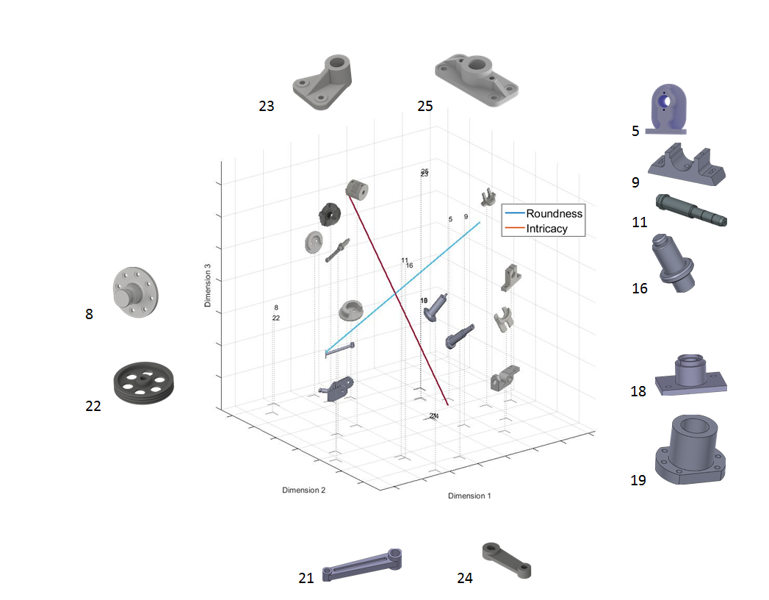
Designers think about the design of parts
1st dimension: Roundness
2nd dimension: Intricacy

Slide 54
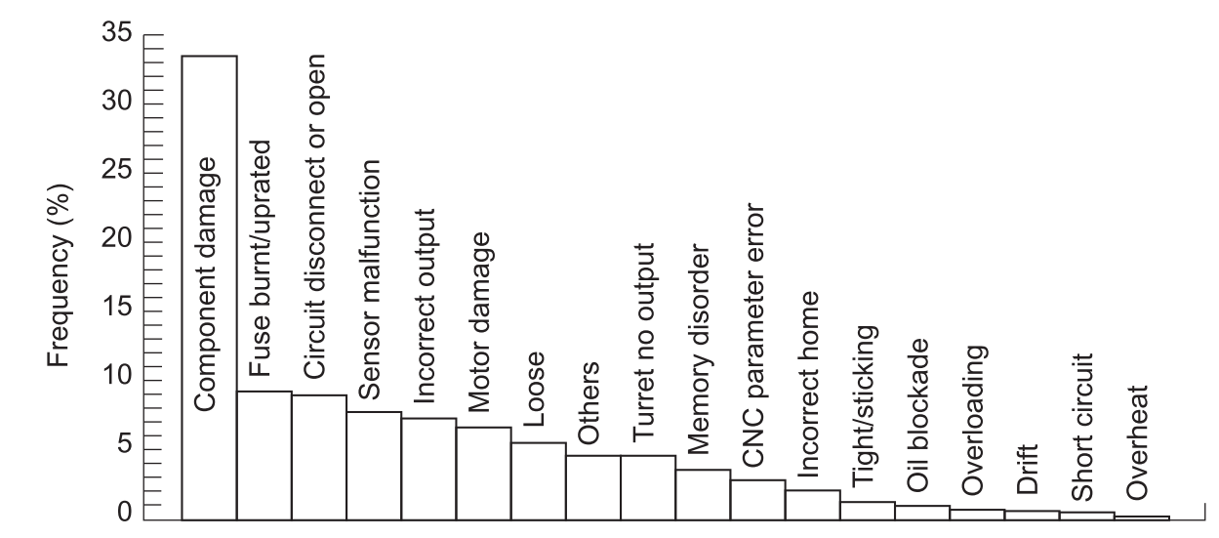
Fabrication failures of subtractive manufacturing
Histogram of detailed failure mode [29]

Slide 55
Collect users’ expertise information from survey

